Slide 1
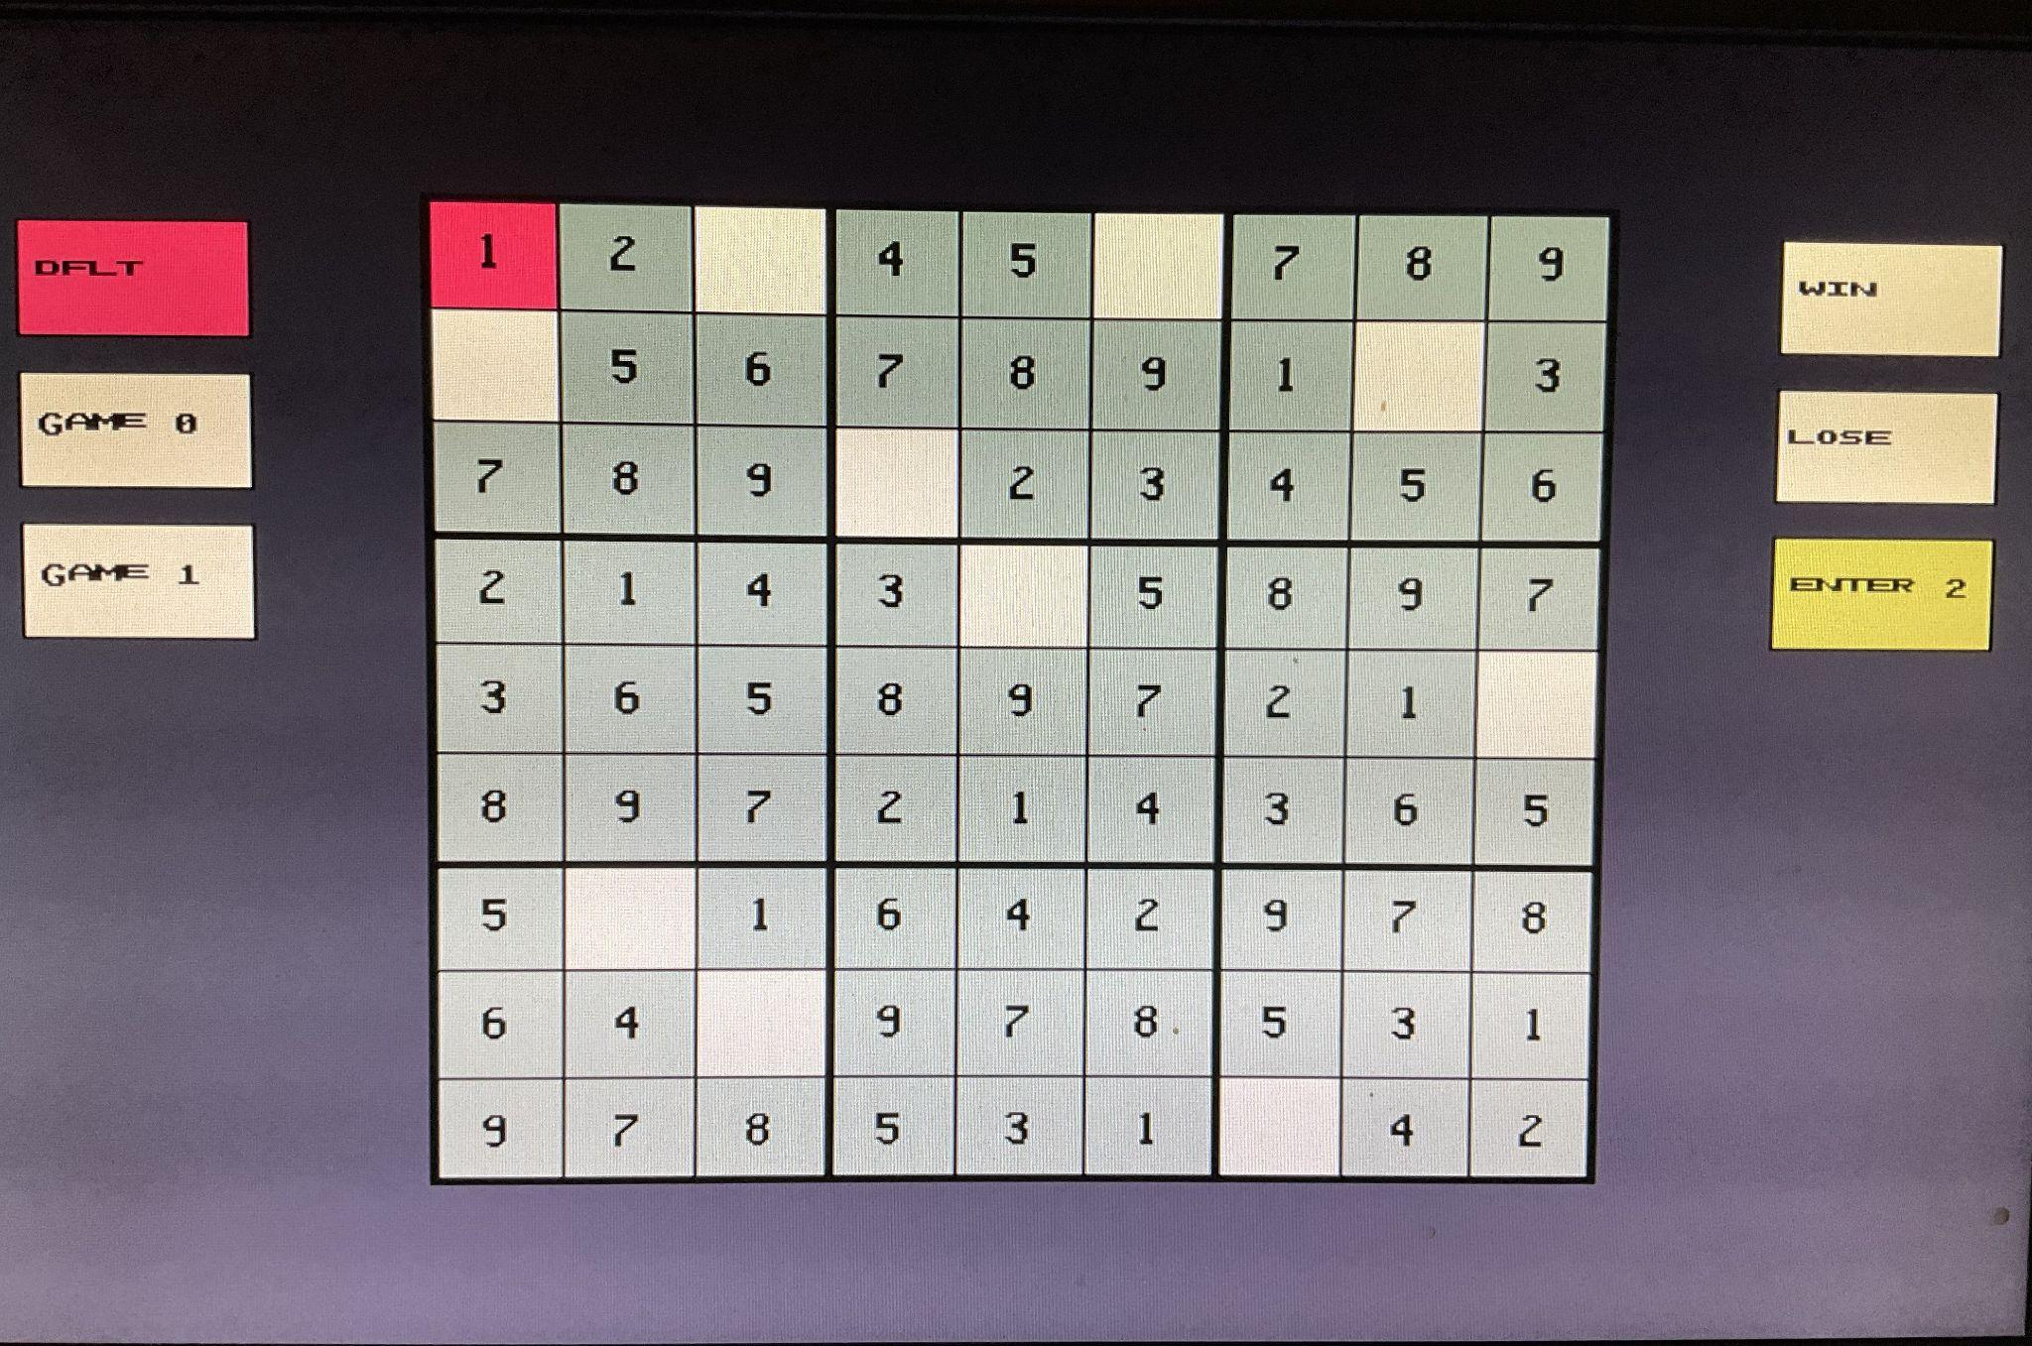



Slide 2
VGA SUDOKU
In a world where VGA pixels fear misalignment and Sudoku boards rise from ancient ROMs, two brave (not quite) engineers step forward.Armed only with a Basys3 board 25 MHz of raw pixel power, and an unreasonable amount of nested always blocks, they embark on a quest to build the ultimate hardware Sudoku machine. No CPUs. No frame buffers. Just pure HDL heroism-ism…
Press START to continue…

Slide 3
Project Overview (Constantine)
Key Features:
Puzzle selection (SW0, SW1)
Solution Checking (SW2)
4-Directional Move Logic
Seven Segment display integration
Cursor position tracking for automatic number selection in NUMBER mode
Cursor flashing logic using bit 26 of a counter (~0.67s period)
Module Hierarcy
top.sv (Top-level module)
├── clock_divider.sv - 100MHz → 25MHz
├── vga_controller.sv - VGA timing generation
├── conditioner.sv (×5) - Button debounce/one-pulse
├── sudoku_engine.sv - Game logic (integrated design)
├── sudoku_draw.sv - VGA pixel rendering
│ ├── digit_font.sv - 8×12 digit bitmaps
│ └── letter_font.sv - 8×12 letter bitmaps
└── sevenseg_sudoku.sv - 7-segment controller
└── sevenseg.sv - Low-level 7-seg driver

Slide 4
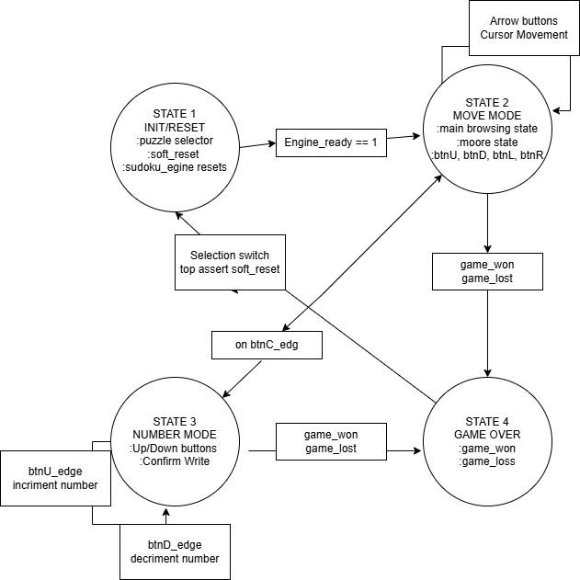
State Machines: Top
Mode | Button Functions | Cursor Display
MODE_MOVE | U/D/L/R: cursor movement, C: switch to NUMBER | Solid (always visible)
MODE_NUMBER | U/D: increment/decrement number, C: enter value | Flashing (~0.67s period)
Notes:
Top.sv
3.1 top.sv - Top-Level Module
Authors: Gwendolyn Beecher, Constantine Hinds
Lines: 278
Purpose: Top-level integration module that instantiates and connects all subsystems.
Key Features:
Switch synchronizers for stable puzzle selection (SW0, SW1)
Correctness mode enable via SW2 (check_enable signal)
Soft reset generation when puzzle selection changes
Mode logic (MOVE vs NUMBER) with center button toggle
Cursor position tracking for automatic number selection in NUMBER mode
Cursor flashing logic using bit 26 of a counter (~0.67s period)

Slide 5
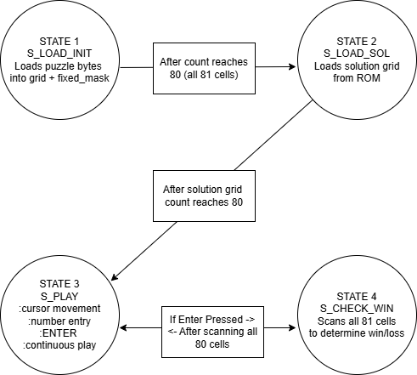
State Machines: Sudoku Engine (Constantine)
State | Description | Transition
S_LOAD_INIT | Load puzzle grid from ROM | → S_LOAD_SOL after 81 cycles
S_LOAD_SOL | Load solution grid from ROM | → S_PLAY after 81 cycles
S_PLAY | Active gameplay (cursor, entry) | → S_CHECK_WIN on ENTER
S_CHECK_WIN | Verify solution correctness | → S_PLAY after 81 cycles
Notes:
3.2 sudoku_engine.sv - Game Engine
Authors: Gwendolyn Beecher, Constantine Hinds
Lines: 221
Purpose: Central game engine that handles puzzle loading, cursor movement, number entry, and correctness checking.
Architecture:
Internal storage arrays: grid[0:8][0:8], solution[0:8][0:8], fixed_mask[0:8][0:8]
Direct ROM loading via $readmemh("puzzles.mem", puzzle_rom)
Nibble extraction for cell values from packed ROM data
Combinational grid exposure (always_comb) for zero-latency VGA display
Real-time cell_match computation when check_enable is active
Integrated cursor movement with wrap-around (0↔8)
1. The Core Components
The engine relies on three main 9x9 grids stored in memory:
grid: The "live" board the player sees and interacts with.
solution: The correct answer key (hidden from the player), used to check for victory.
fixed_mask: A write-protection layer. If a cell is 1 here, it was part of the original puzzle clue, and the player is not allowed to change it.
2. How Puzzles are Loaded
The module uses a .mem file (puzzles.mem) which acts like a game cartridge containing multiple puzzles.
puzzle_selector: A 2-bit input that lets you choose between 3 different puzzles (indices 0-2).
The Loading Process:
State S_LOAD_INIT: The engine reads the initial puzzle layout from the ROM (Read-Only Memory). It fills the grid. Any non-zero number is marked as "fixed" in the fixed_mask.
State S_LOAD_SOL: It reads the matching solution from the ROM and stores it in the hidden solution grid.
State S_PLAY: Once loading is done (after 81 cycles for the grid + 81 for the solution), the game begins.
3. Gameplay Mechanics (State S_PLAY)
This is the main loop where the player interacts with the game.
Cursor Movement
The code listens for directional commands (cmd_up, cmd_down, etc.). It uses "wrap-around" logic:
If you are at the top edge (current_y == 0) and press UP, the cursor wraps to the bottom (8).
This makes navigation faster and more fluid.
Entering Numbers
Input: If a valid number command comes in (number_evt != 0).
Guardrail: It checks !fixed_mask[current_y][current_x].
Translation: "Is this cell write-protected?"
If No: It updates the grid with the new number.
If Yes: It ignores the input, preventing the player from cheating or breaking the puzzle setup.
4. Victory Check
There are actually two ways this code checks for a win:
Method A: The "Enter" Key (State Machine)
When the player presses ENTER (enter_evt):
The state moves to S_CHECK_WIN.
It scans every cell one by one (taking 81 clock cycles).
If any cell in grid does not match solution, it sets game_lost = 1 and game_won = 0.
If the scan finishes without errors, game_won remains 1.
Method B: The "Debug" Switch (Combinational Logic)
There is a separate, instant check controlled by the check_enable switch (likely a physical switch on the FPGA board):
This runs inside the always_comb block at the bottom.
It compares every cell instantly in parallel (loops in always_comb unroll into hardware).
Outputs:
check_win: High if the board is perfect.
cell_match: A 9x9 grid of bits showing exactly which cells are correct (useful for debugging or hints).
5. Hardware Implementation Details
timescale 1ns / 1ps: Sets the simulation time units (standard for digital logic).
rom_idx_init / rom_idx_sol: The ROM is organized in pairs. Even indices (0, 2, 4) hold the puzzles; odd indices (1, 3, 5) hold the solutions.
Nibble Extraction: nibble_init = puzzle_rom...: This complex line slices out 4 bits (a "nibble") at a time from the long ROM data to fill the grid cell by cell.
Summary
This module acts as the Model and Controller in a Model-View-Controller (MVC) architecture. It holds the data (Model) and processes the inputs (Controller), then sends the grid_out to a separate VGA module (the View) to display it on a screen.

Slide 6
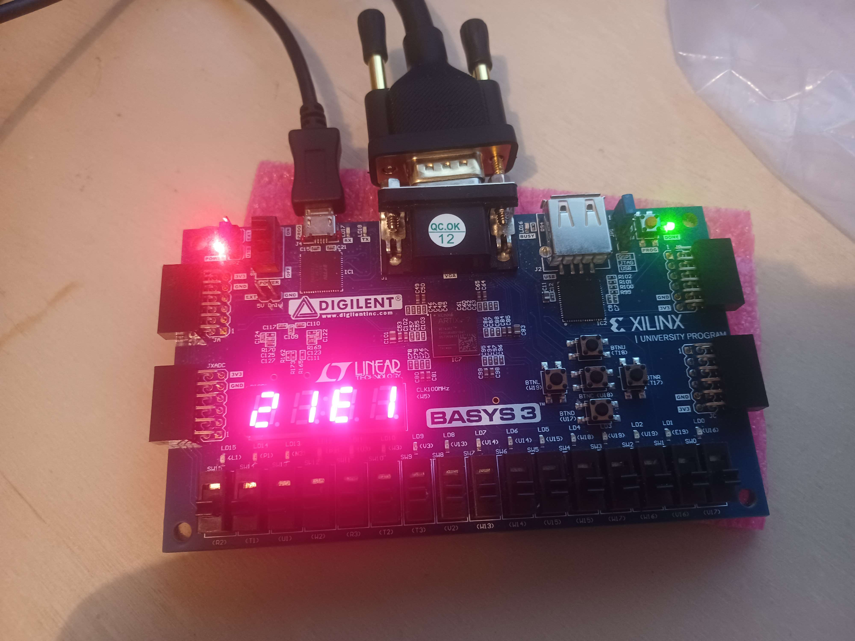
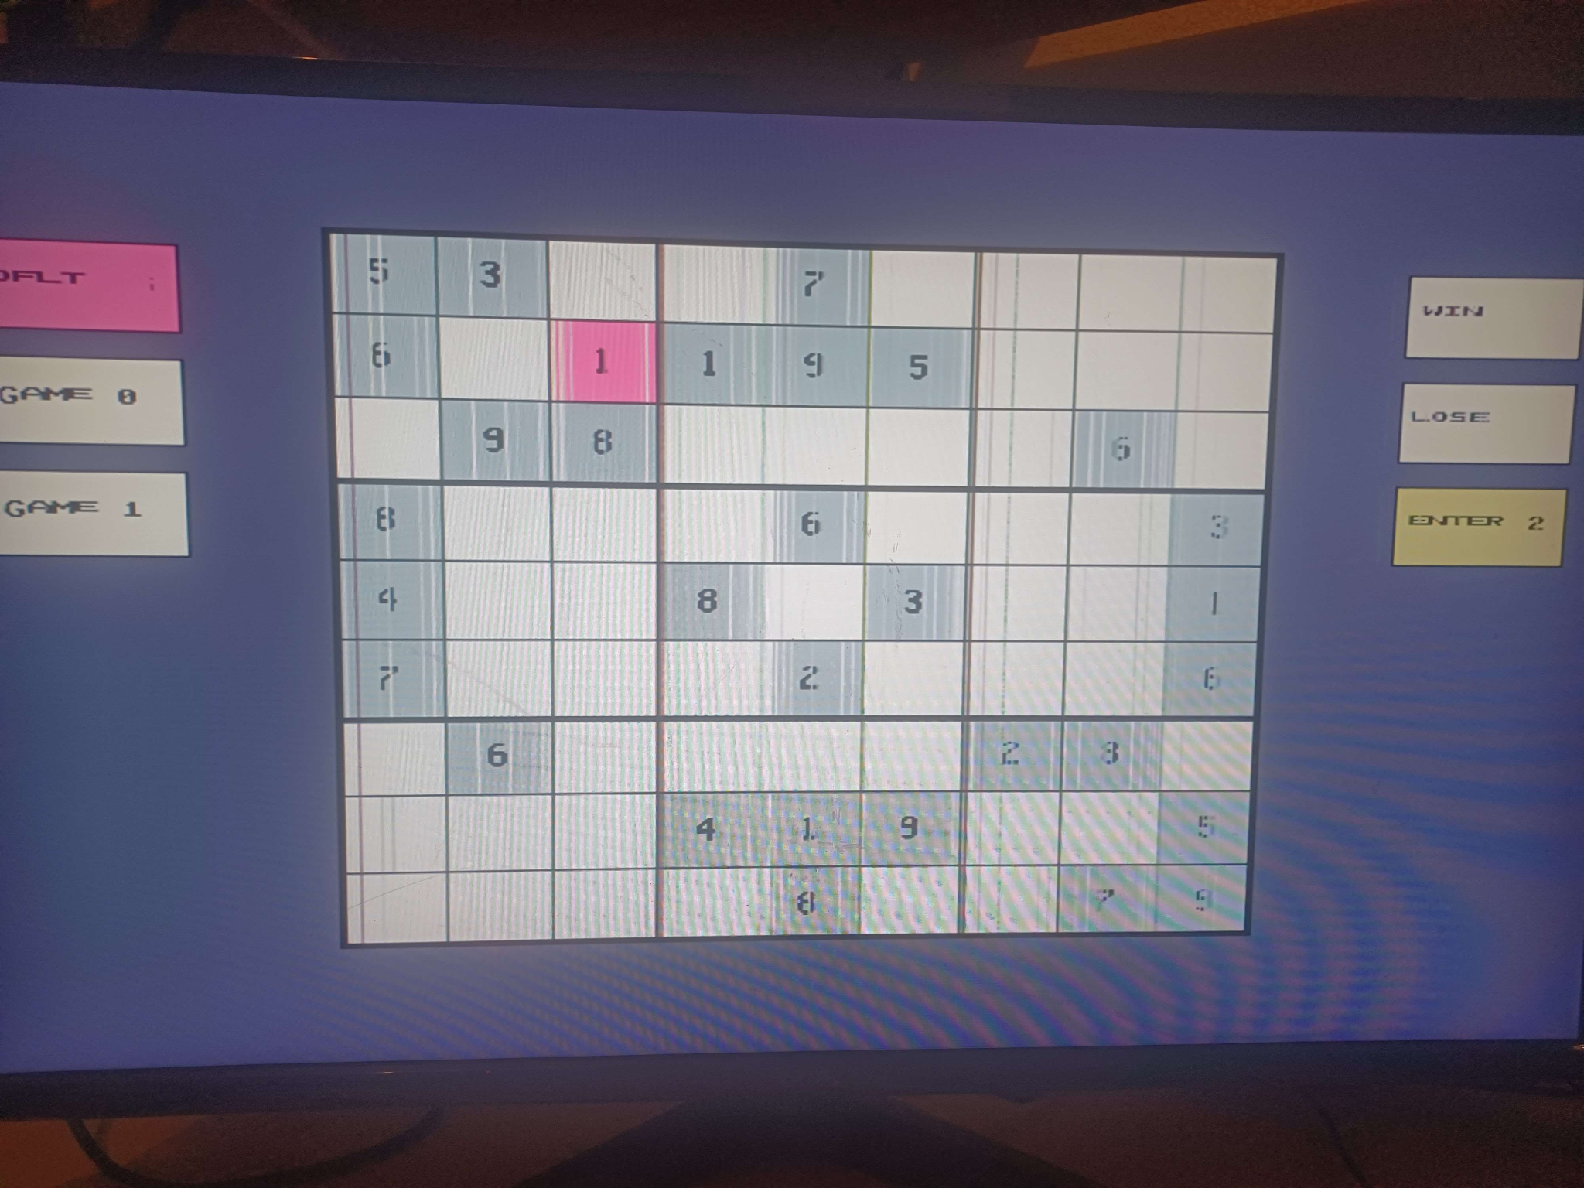
Seven Segment Module (Constantine)
Digits 0 & 1 (Navigation): current X (Column) and Y (Row) coordinates (0–8)
Digit 2 (Status Indicator): mode flag digit;
Displays an 'E' when editing a number (NUMBER mode)
Remains Blank when moving around the grid (MODE_MOVE)
Digit 3 (The Flashing Value): This digit displays the current value
NUMBER mode: slow sevenseg_flash signal – blinking (2^25 cycles)
Else static (MODE_MOVE)
Digit | MODE_MOVE | NUMBER (editable)
0 (left) | X position (0-8) | X position (0-8)
1 | Y position (0-8) | Y position (0-8)
2 | Blank | 'E' (Edit indicator)
3 (right) | Current cell value | Flashing selected number
Notes:
It takes the very fast "heartbeat" of your hardware (the system clock) and slows it down significantly to create a human-visible blinking effect (a "slow flash") for a 7-segment display.
1. The High-Level Concept: The Odometer Analogy
Imagine the odometer in a car.
The rightmost digit (the 1/10th mile) spins very fast.
The digit to the left of it spins 10 times slower.
The digit all the way to the left takes a very long time to change.
In this code, the clk is the engine spinning the rightmost digit. The signal sevenseg_flash is the digit all the way on the left.
2. Line-by-Line Explanation
logic [25:0] sevenseg_flash_div;
What it is: This declares a "container" (a register) named sevenseg_flash_div.
Size: It is 26 bits wide ([25:0]). This means it can hold a number from 0 up to $2^{26} - 1$ (roughly 0 to 67 million).
always_ff @(posedge clk) sevenseg_flash_div <= sevenseg_flash_div + 1;
What it is: This is the engine. It is a sequential logic block (always_ff) triggered by the rising edge of the clock (posedge clk).
Action: Every single time the system clock ticks (which happens millions of times a second), the value inside the container increases by 1.
Result: This creates a free-running binary counter. It counts up, overflows back to 0, and counts up again, forever.
logic sevenseg_flash = sevenseg_flash_div[25];
What it is: This creates the final output signal sevenseg_flash.
Action: It ignores the fast-changing lower numbers and "wires" this signal directly to bit 25 (the 26th bit, which is the Most Significant Bit or MSB).
Why bit 25? In binary counting, the MSB is the slowest changing bit. While bit 0 flips every cycle, bit 25 flips only after $2^{25}$ cycles.
3. The Math: How slow is "Slow"?
To understand the actual speed of this flash, we have to look at the math of Frequency Division.
The frequency of the output bit $N$ is determined by this formula:
$$f_{out} = \frac{f_{clk}}{2^{N+1}}$$
Assuming your FPGA or system clock (clk) is running at the standard 50 MHz (50 million cycles per second):
The Counter Size: $2^{26} = 67,108,864$ total states.
The Period: The counter takes roughly 67 million ticks to go from 0 to full. $$\text{Time} = \frac{67,108,864 \text{ cycles}}{50,000,000 \text{ cycles/sec}} \approx 1.34 \text{ seconds}$$
The Behavior: The MSB (Bit 25) will be LOW for the first half of that time (0.67s) and HIGH for the second half (0.67s).
The Result: A light controlled by this signal will blink on and off roughly every 1.34 seconds.
Summary
You are building a massive counter to "waste time." By looking only at the highest bit of that counter, you turn a clock that ticks 50 million times a second into a signal that toggles less than once a second—perfect for a visual indicator like a blinking dot on a 7-segment display.

Slide 7
Before anything can be drawn, the VGA controller must generate valid VGA timing:
Hsync
Vsync
(x, y) pixel coordinates
video_on (whether the pixel is visible)
vga_controller VGA(
.clk25(clk25),
.reset(reset),
.hsync(Hsync),
.vsync(Vsync),
.x(x),
.y(y),
.video_on(video_on)
);
The FPGA outputs one pixel every 40 ns (25MHz) For each pixel, VGA gives you:
X (horizontal) and Y (Vertical)
This is the foundation of the entire renderer. Every pixel that appears on the screen is chosen based on (x,y)

Slide 8
Color Generation:
Board Geometry:
Digit Font Rendering
function automatic void SET_COLOR(
input [11:0] c,
output [3:0] r,
output [3:0] g,
output [3:0] b
);
r = c[11:8];
g = c[7:4];
b = c[3:0];
endfunction
col = rel_x / CELL_SIZE;
row = rel_y / CELL_SIZE;
if (dsrc != 0 &&
cell_x >= dx0 && cell_x < dx0+8 &&
cell_y >= dy0 && cell_y < dy0+12)
begin
digit_value = dsrc;
digit_row = cell_y - dy0;
bit_idx = cell_x - dx0;
if (digit_bits[7-bit_idx])
draw_d = 1'b1;
end
Board Rendering
thick = ((rel_x % (CELL_SIZE*3)) <= 2 ||
(rel_y % (CELL_SIZE*3)) <= 2 ||
rel_x <= 2 || rel_y <= 2 ||
rel_x >= BOARD_W-3 || rel_y >= BOARD_H-3);
thin = (!thick &&
((rel_x % CELL_SIZE == 0) ||
(rel_y % CELL_SIZE == 0)))

Slide 9
Letter Rendering: Bitmap
Color Priority Layering
always_comb begin
case (ch)
CH_A: case (row)
0: bits = 8'b00111100;
1: bits = 8'b01100110;
2: bits = 8'b01100110;
3: bits = 8'b01111110;
4: bits = 8'b01100110;
5: bits = 8'b01100110;
default: bits = 8'b00000000;
endcase
CH_E: case (row)
0: bits = 8'b01111110;
1: bits = 8'b01100000;
2: bits = 8'b01111100;
3: bits = 8'b01100000;
4: bits = 8'b01111110;
default: bits = 8'b00000000;
endcase
endcase
end
1. Borders always win (top priority)
if (thick)
SET_COLOR(COLOR_LINE, red, green, blue);
else if (thin)
SET_COLOR(COLOR_LINE, red, green, blue);
2. Correctness mode overrides normal colors
if (check_enable) begin
if (cell_match[row][col])
SET_COLOR(COLOR_GOOD, red, green, blue);
else
SET_COLOR(COLOR_BAD, red, green, blue);
3. Normal mode
if (is_cursor && flash_state) // cursor blink
SET_COLOR(COLOR_CURSOR, red, green, blue);
else if (is_fixed) // preset cells
SET_COLOR(COLOR_PREFILL, red, green, blue);
else // normal editable cell
SET_COLOR(COLOR_CELL, red, green, blue);
4. Digits drawn LAST (always on top)
if (draw_d)
SET_COLOR(COLOR_NUM, red, green, blue);

Slide 10
